Slide 1
Lesson 3: Classification
Eric Keilty

Slide 2
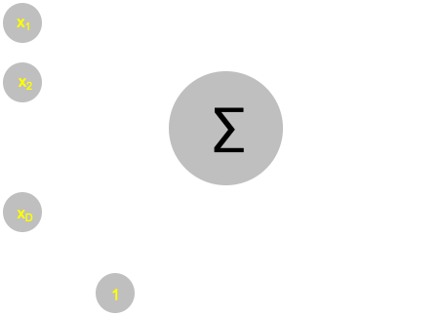
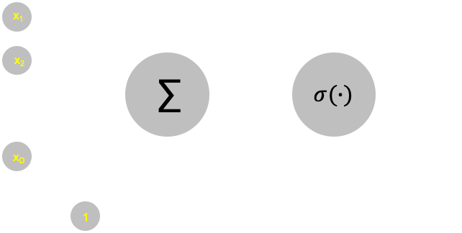
Binary Classification
Linear Regression:
fully connected: D inputs to 1 output
A linear activation function (no activation function) on the output
Typically the “MSE” loss function is used for training
Logistic Regression:
fully connected: D inputs to 1 output
A sigmoid activation function on the output
Typically the “Log Loss” loss function is used for training

Slide 3
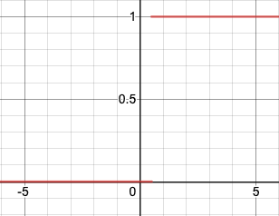
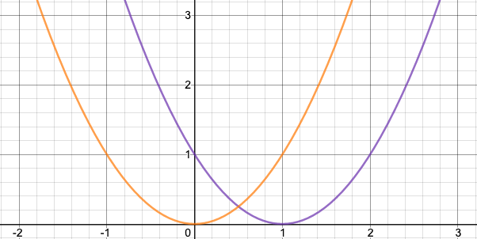
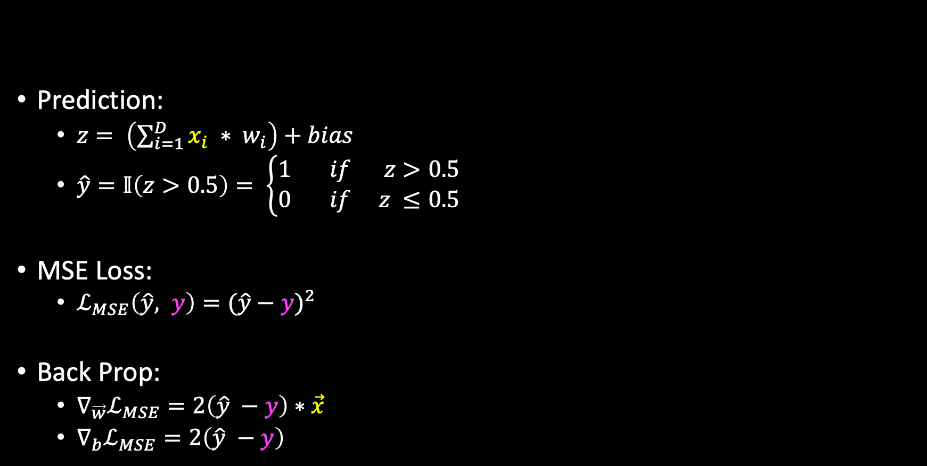
Linear Regression - Math
Prediction:
$z= \left(\sum_{i=1}^{D}{x_{i} ∗ w_{i}}\right)+bias$
$\hat{y}=𝕀\left(z>0.5\right)= \left\{\begin{aligned}1 if z>0.5 \\ 0 if z ≤0.5\end{aligned}\right.$
MSE Loss:
$ℒ_{MSE}\left(\hat{y}, y\right)={(\hat{y}−y)}^{2}$
Back Prop:
$∇_{\vec{w}}ℒ_{MSE}=2\left(\hat{y} −y\right)∗\vec{x}$
$∇_{b}ℒ_{MSE}=2\left(\hat{y} −y\right)$
Hard Decision Boundary

Slide 4
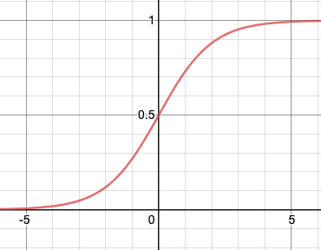
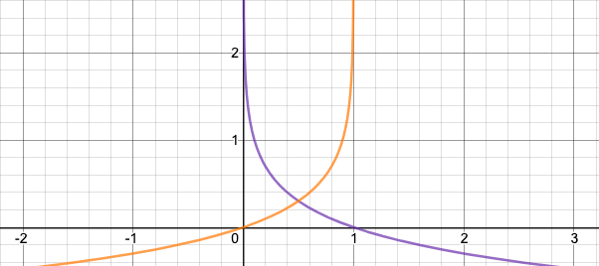
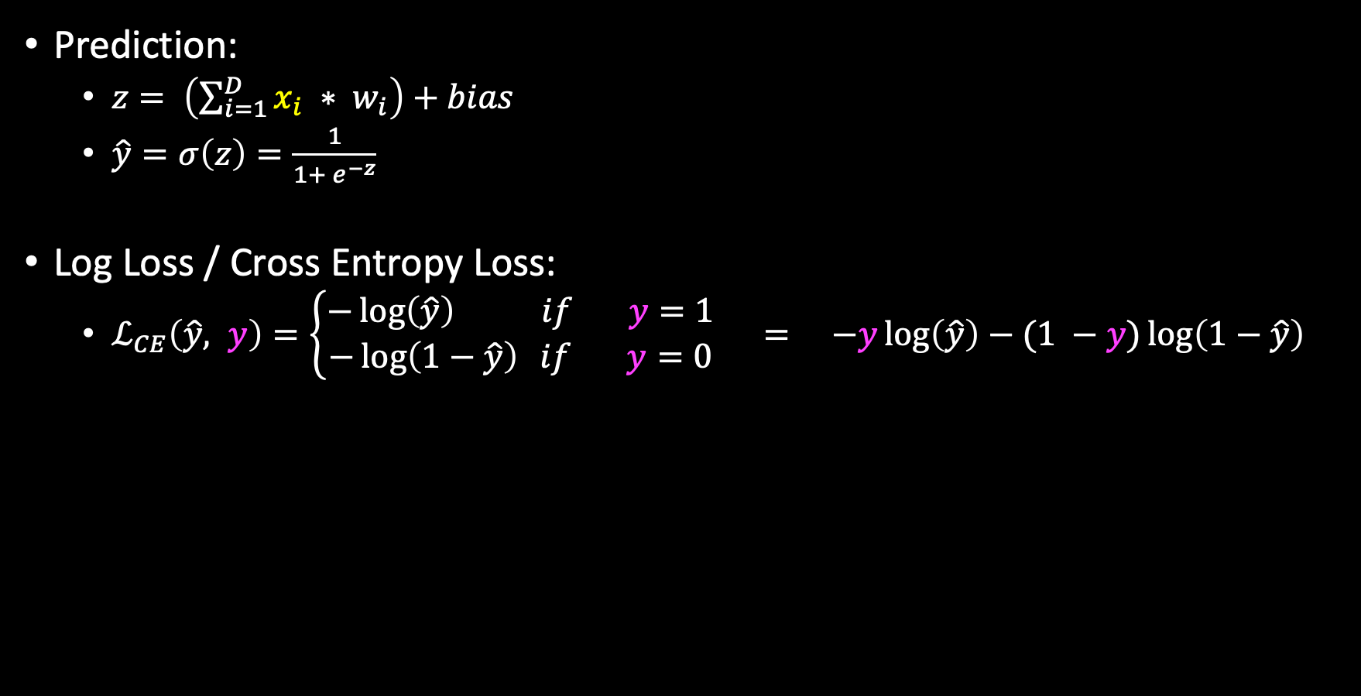
Logistic Regression - Math
Prediction:
$z= \left(\sum_{i=1}^{D}{x_{i} ∗ w_{i}}\right)+bias$
$\hat{y}=σ\left(z\right)=\frac{1}{1+ e^{−z}}$
Log Loss / Cross Entropy Loss:
$ℒ_{CE}\left(\hat{y}, y\right)=\left\{\begin{aligned}−\log\left(\hat{y}\right) if y=1 \\ −\log\left(1−\hat{y}\right) if y=0\end{aligned}\right. = −y\log\left(\hat{y}\right)−(1 −y)\log\left(1−\hat{y}\right)$
soft Decision Boundary

Slide 5
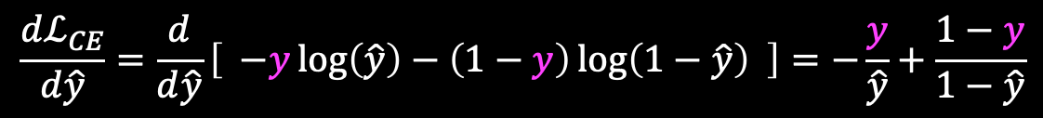
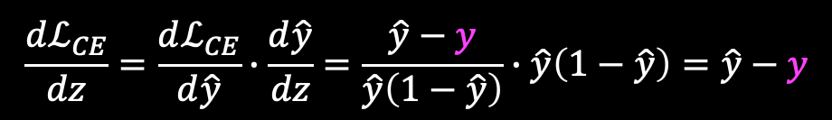
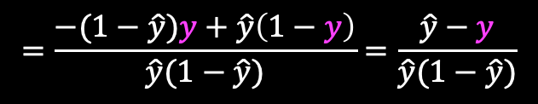


Logistic Regression – Backpropagation
$$\frac{dℒ_{CE}}{d\hat{y}}=\frac{d}{d\hat{y}}\left[ −y\log\left(\hat{y}\right)−\left(1−y\right)\log\left(1−\hat{y}\right) \right]=−\frac{y}{\hat{y}}+\frac{1−y}{1−\hat{y}}$$
$$=\frac{−(1−\hat{y})y+\hat{y}\left(1−y\right)}{\hat{y}(1−\hat{y})}=\frac{\hat{y}−y}{\hat{y}(1−\hat{y})}$$
$$\frac{d\hat{y}}{dz}=σ^{′\left(z\right)}=\frac{d}{dz}\left[ \frac{1}{1+ e^{−z}} \right]=\frac{e^{−z}}{{(1+ e^{−z})}^{2}}$$
$$=\frac{1}{1+ e^{−z}}∙\frac{e^{−z}}{1+ e^{−z}}=\frac{1}{1+ e^{−z}}∙\left(1 −\frac{1}{1+ e^{−z}}\right)=\hat{y}(1−\hat{y})$$
$$\frac{dℒ_{CE}}{dz}=\frac{dℒ_{CE}}{d\hat{y}}∙\frac{d\hat{y}}{dz}=\frac{\hat{y}−y}{\hat{y}\left(1−\hat{y}\right)}∙\hat{y}\left(1−\hat{y}\right)=\hat{y}−y$$
Called the Logit Loss values
Logits are the values before passing into the sigmoid activation (i.e. z)

Slide 6
Difference Between Linear and Logistic Regression
Hard vs Soft Decision
Linear regression punishes wrong guesses polynomials, where linear regression punishes wrong guesses exponentially

Slide 7
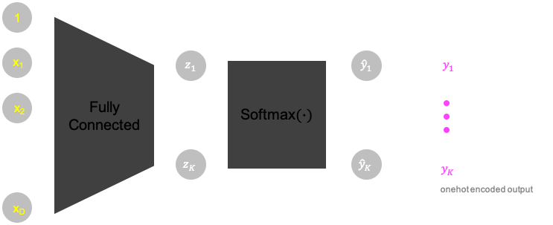
Multiclass / Multilabel Classification
fully connected: d inputs to K output
A softmax activation function on the output
Typically the “Log Loss” loss function is used for training

Slide 8


What is Softmax?
Softmax is the generalization of the Sigmoid function
Sigmoid can only take 1 input and can be used to classify data with 2 labels
Softmax can take in K inputs and can be used to classify data with K labels
$$Sigmoid\left(z\right)=\frac{1}{1+ e^{−z}}$$
$$Softmax\left(z_{i}, \vec{z} \right)=\frac{e^{z_{i}}}{\sum_{j=1}^{K}{e^{z_{j}}}}$$
Some people include the entire vector as a second parameter, since you technically need it to compute the value

Slide 9
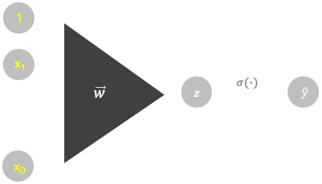
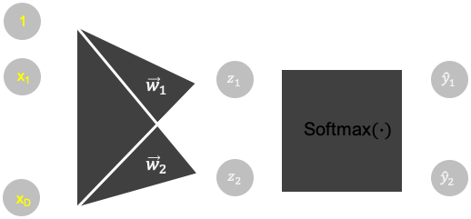

Assignment 3: Part 1
Consider a Logistic Binary Classification and a Multiclass Classification with K = 2
Can you find the relationship between $\vec{w}$ and $\{{\vec{w}}_{1},{\vec{w}}_{2}\}$ such that each classifier makes the same prediction for any input $\vec{x} ε ℝ^{D}$
Hint: $\hat{y}={\hat{y}}_{2}$

Slide 10

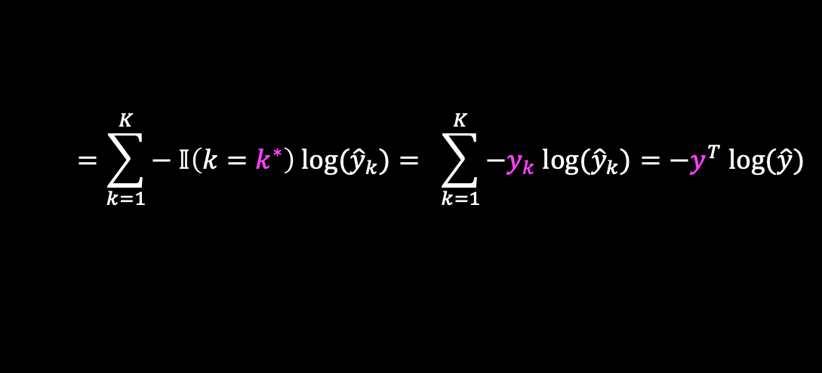
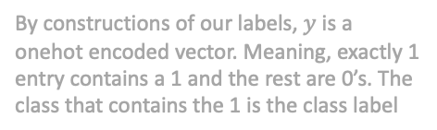
Assignment 3: Part 2
Determine $\frac{dℒ_{CE}}{d\vec{z}}$ for a multiclass regression
$z_{k}= {\vec{w}}_{k}^{T} \vec{x}$
${\hat{y}}_{k}=Softmax(z_{k})$
Now, $\hat{y}$ and $y$ are both vectors that correspond to the class labels
Let ${argmax}_{k=\{1, …, K\}} \hat{y}≡ \hat{k}$ (predicted class label)
Let ${argmax}_{k=\{1, …, K\}} y≡k^{∗}$ (actual class label)
$ℒ_{CE}\left(\hat{y}, y\right)=−\log\left({\hat{y}}_{k^{∗}}\right)$
Hints
Find the derivative component-wise, i.e. $\frac{dℒ_{CE}}{dz_{k}}$
When computing $\frac{d{\hat{y}}_{i}}{dz_{k}}$, split it into 2 cases: $i=k$ and $i≠k$
Do not evaluate $\frac{dℒ_{CE}}{d{\hat{y}}_{i}}$, evaluate $\frac{dℒ_{CE}}{dz_{k}}$ and use $\frac{d{\hat{y}}_{i}}{dz_{k}}$ when you apply the chain rule
By constructions of our labels, $y$ is a onehot encoded vector. Meaning, exactly 1 entry contains a 1 and the rest are 0’s. The class that contains the 1 is the class label
$$=\sum_{k=1}^{K}{− 𝕀\left(k=k^{∗}\right) log⁡({\hat{y}}_{k})}= \sum_{k=1}^{K}{−y_{k} log⁡({\hat{y}}_{k})}=−y^{T} log⁡(\hat{y})$$

Slide 11
Assignment 3: Part 3
We will be going back to the toy problem from assignment 1: classifying an “X”
We are using the exact same dataset, except this time we are doing a logistic binary classification and a multiclass classification
The goal of this assignment is to get more practice with PyTorch and to get some experience with the different functions you will be using most often in practice

Slide 12
Assignment 3: Part 3 PyTorch Documentation
https://pytorch.org/docs/stable/nn.html
If not during this assignment, this will be helpful to you in the future
Some specific functions we are using in this assignment
torch.nn.BCEWithLogitsLoss()
torch.nn.CrossEntropyLoss()
torch.nn.Sigmoid()
torch.nn.Softmax()

Slide 13
Aside: Miscellaneous Stuff about MLPs

Slide 14
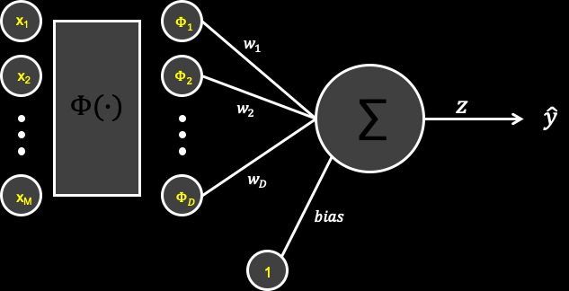





Non-Linear Transformations
$$x_{2}$$
$$x_{1}$$
$$Φ(∙)$$
$$Φ_{2}$$
$$Φ_{1}$$

Slide 15
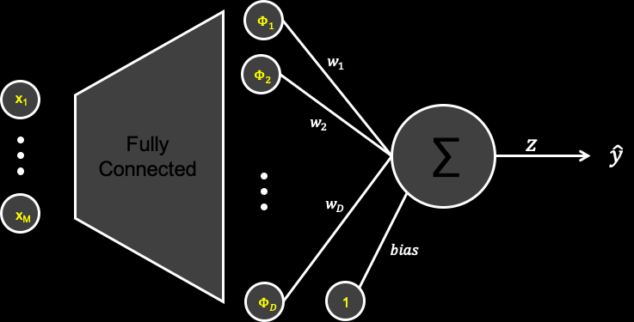
Universal Approximation Theorem (1989)
A single hidden layer (with many neurons) couple with any smooth nonlinear activation function can approximate any function
Then why is deep learning instead of shallowing learning the popular approach?

Slide 16
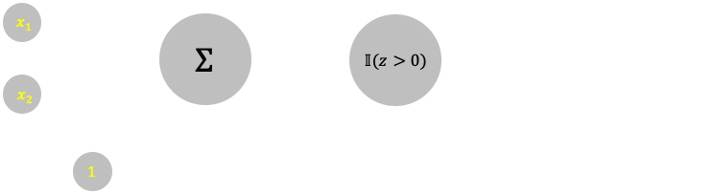
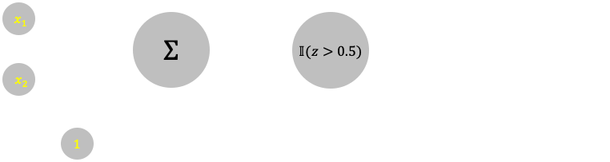
Neural Networks as Boolean Circuits
OR
AND

Slide 17
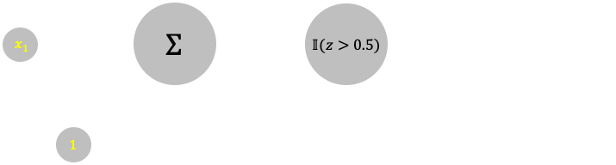
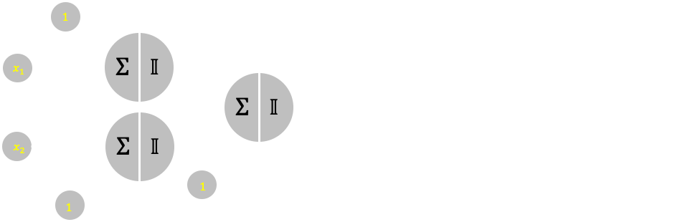
Neural Networks as Boolean Circuits
NOT
XOR
Recall: $A ⨂B=A∙\overline{B}+\overline{A}∙B=(A+B)∙(\overline{A}+\overline{B})$

Slide 18
Appendix

Slide 19







Linear Regression
x₁
$$w_{1}$$
x₂
$$w_{2}$$
∑
$$z$$
$$\hat{y}$$
$$y$$
$$w_{D}$$
x_{D}
$$bias$$
1

Slide 20








Logistic Regression
x₁
$$w_{1}$$
x₂
$$w_{2}$$
∑
$$z$$
$$σ(∙)$$
$$\hat{y}$$
$$y$$
$$w_{D}$$
x_{D}
$$bias$$
1

Slide 21






















General MLP Architecture
$${\vec{x}}^{(ℓ)}=\left[\begin{matrix}1 \\ x_{1} \\ \begin{matrix}⋮ \\ x_{d^{(ℓ)}}\end{matrix}\end{matrix}\right]∈ ℝ^{d^{(ℓ)}+1}, W^{(ℓ)}=\left[w_{ji}^{(ℓ)}\right]∈ ℝ^{{ d}^{(ℓ)}{ × (d}^{(ℓ−1)}+1)}$$
$$1$$
$$1$$
$$φ(∙)$$
$$σ(∙)$$
$$y_{1}$$
$$s_{1}^{(1)}$$
$$z_{1}^{(L)}$$
$${\hat{y}}_{1}$$
$$x_{1}^{(0)}$$
$$x_{1}^{(1)}$$
$$W^{(1)}$$
$$s_{d^{(1)}}^{(1)}$$
$$σ(∙)$$
$$φ(∙)$$
$$z_{d^{(L)}}^{(L)}$$
$${\hat{y}}_{d^{(L)}}$$
$$y_{d^{(L)}}$$
$$x_{d^{(0)}}^{(0)}$$
$$x_{d^{(1)}}^{(1)}$$
onehot encoded output
Same as ${\vec{s}}_{d^{(L)}}^{(L)}$
Same as ${\vec{x}}_{d^{(L)}}^{(L)}$

Slide 22







Multiclass / Multilabel Classification Architecture
1
x₁
$$z_{1}$$
$${\hat{y}}_{1}$$
$$y_{1}$$
x₂
Fully Connected
Softmax$(∙)$
$$z_{K}$$
$${\hat{y}}_{K}$$
$$y_{K}$$
onehot encoded output
x_{D}

Slide 23




Homework: Logistic Classification Diagram
1
x₁
$$σ(∙)$$
$$\vec{w}$$
$$z$$
$$\hat{y}$$
x_{D}

Slide 24







Homework: Multiclass Classification Diagram
1
x₁
$${\vec{w}}_{1}$$
$$z_{1}$$
$${\hat{y}}_{1}$$
Softmax$(∙)$
$${\vec{w}}_{2}$$
$$z_{2}$$
$${\hat{y}}_{2}$$
x_{D}

Slide 25





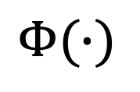




Non-Linear Transformations
x₁
$$Φ_{1}$$
$$w_{1}$$
x₂
$$Φ_{2}$$
$$Φ(∙)$$
∑
$$z$$
$$w_{2}$$
$$\hat{y}$$
$$w_{D}$$
x_{M}
$$Φ_{D}$$
$$bias$$
1

Slide 26









Universal Approximation Theorem
$$Φ_{1}$$
$$w_{1}$$
$$Φ_{2}$$
x₁
$$w_{2}$$
Fully Connected
∑
$$z$$
$$\hat{y}$$
$$w_{D}$$
x_{M}
$$bias$$
$$Φ_{D}$$
1

Slide 27

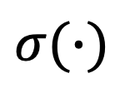









OR Gate
$$σ(∙)$$
$$x_{1}$$
$$1$$
$$z$$
$$Σ$$
$\hat{y}$ $=OR(x_{1}, x_{2})$
$$𝕀(z>0)$$
$$x_{2}$$
$$1$$
$$−0.25$$
$$1$$

Slide 28










AND Gate
$$σ(∙)$$
$$x_{1}$$
$$1$$
$$z$$
$$Σ$$
$$\hat{y}=AND(x_{1}, x_{2})$$
$$𝕀(z>0.5)$$
$$x_{2}$$
$$1$$
$$−1.25$$
$$1$$

Slide 29







NOT Gate
$$−1$$
$$z$$
$$Σ$$
$$\hat{y}=NOT(x_{1})$$
$$x_{1}$$
$$𝕀(z>0.5)$$
$$1.25$$
$$1$$

Slide 30
















XOR Gate
$$1$$
$$−1.25$$
$$1$$
$$Σ$$
$$𝕀$$
$$x_{1}$$
$$1$$
$$1$$
$$Σ$$
$$𝕀$$
$$\hat{y}=AND\left({OR(x}_{1}, x_{2}\right), AND(x_{1}, x_{2}))$$
$$1$$
$$Σ$$
$$𝕀$$
$$1$$
$$x_{2}$$
$$1$$
$$−1.25$$
$$1$$
$$−0.25$$
$$1$$

